Slide 1
Unit 03: Advanced Transaction Processing

Slide 2
Advanced Transaction Processing
Transaction-Processing Monitors
Transactional Workflows
Main memory databases
Real-Time Transaction Systems
Long-Duration Transactions

Slide 3
Transaction Processing Monitors
TP monitors initially developed as multithreaded servers to support large numbers of terminals from a single process.
Provide infrastructure for building and administering complex transaction processing systems with a large number of clients and multiple servers.
Provide services such as:
  Presentation facilities to simplify creating user interfaces
  Persistent queuing of client requests and server responses
  Routing of client messages to servers
  Coordination of two-phase commit when transactions access multiple servers.
Some commercial TP monitors: CICS from IBM, Pathway from Tandem, Top End from NCR, and Encina from Transarc

Slide 4
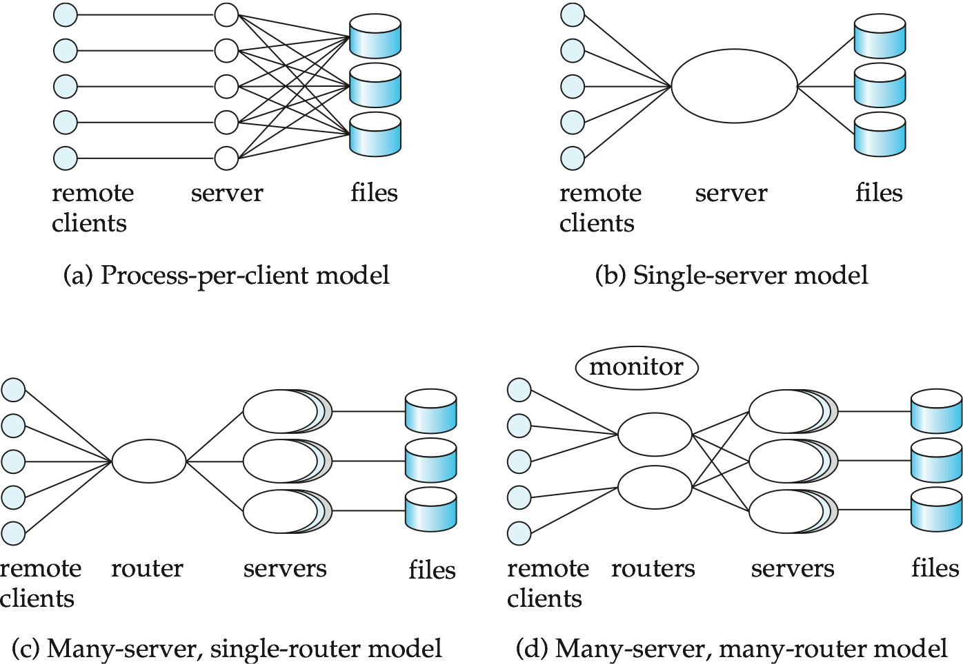
TP Monitor Architectures

Slide 5
TP Monitor Architectures (Cont.)
Process per client model - instead of individual login session per terminal, server process communicates with the terminal, handles authentication, and executes actions.
  Memory requirements are high
  Multitasking- high CPU overhead for context switching between processes
Single process model - all remote terminals connect to a single server process.
  Used in client-server environments
  Server process is multi-threaded; low cost for thread switching
  No protection between applications
  Not suited for parallel or distributed databases

Slide 6
TP Monitor Architectures (Cont.)
Many-server single-router model - multiple application server processes access a common database; clients communicate with the application through a single communication process that routes requests.
  Independent server processes for multiple applications
  Multithread server process
  Run on parallel or distributed database
Many server many-router model - multiple processes communicate with clients.
  Client communication processes interact with router processes that route their requests to the appropriate server.
  Controller process starts up and supervises other processes.

Slide 7
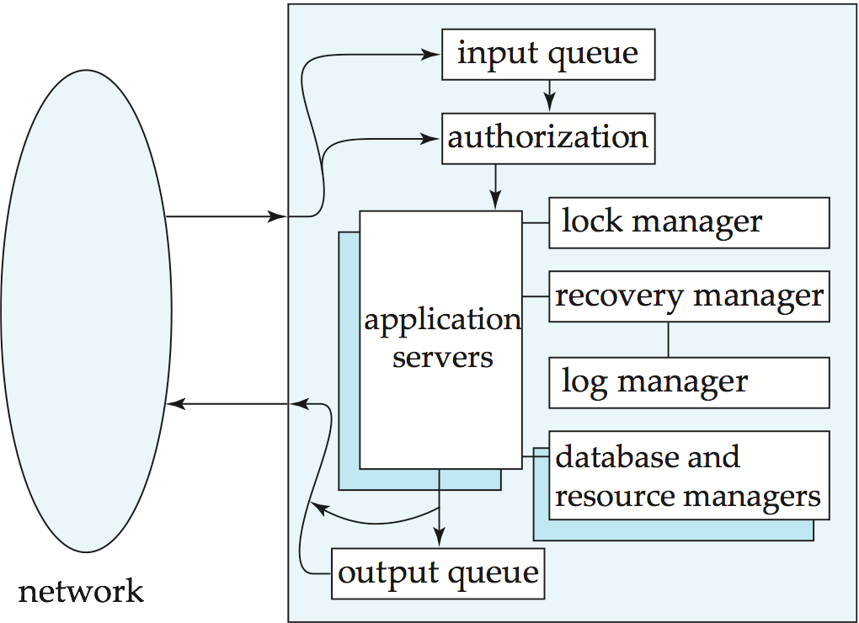
Detailed Structure of a TP Monitor

Slide 8
Detailed Structure of a TP Monitor
Queue manager handles incoming messages
Some queue managers provide persistent or durable message queueing contents of queue are safe even if systems fails.
Durable queueing of outgoing messages is important
  application server writes message to durable queue as part of a transaction
  once the transaction commits, the TP monitor guarantees message is eventually delivered, regardless of crashes.
  ACID properties are thus provided even for messages sent outside the database
Many TP monitors provide locking, logging and recovery services, to enable application servers to implement ACID properties by themselves.

Slide 9
Application Coordination Using
TP Monitors
A TP monitor treats each subsystem as a resource manager that provides transactional access to some set of resources.
The interface between the TP monitor and the resource manager is defined by a set of transaction primitives
The resource manager interface is defined by the X/Open Distributed Transaction Processing standard.
TP monitor systems provide a transactional remote procedure call (transactional RPC) interface to their service
  Transactional RPC provides calls to enclose a series of RPC calls within a transaction.
  Updates performed by an RPC are carried out within the scope of the transaction, and can be rolled back if there is any failure.

Slide 10
Workflow Systems

Slide 11
Transactional Workflows
Workflows are activities that involve the coordinated execution of multiple tasks performed by different processing entities.
With the growth of networks, and the existence of multiple autonomous database systems, workflows provide a convenient way of carrying out tasks that involve multiple systems.
Example of a workflow delivery of an email message, which goes through several mails systems to reach destination.
  Each mailer performs a tasks: forwarding of the mail to the next mailer.
  If a mailer cannot deliver mail, failure must be handled semantically (delivery failure message).
Workflows usually involve humans: e.g. loan processing, or purchase order processing.

Slide 12
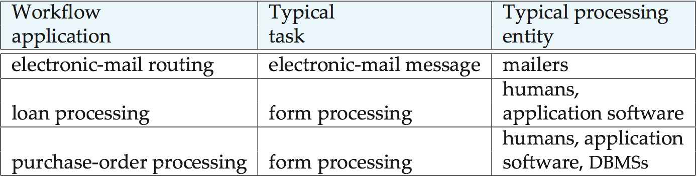
Examples of Workflows

Slide 13
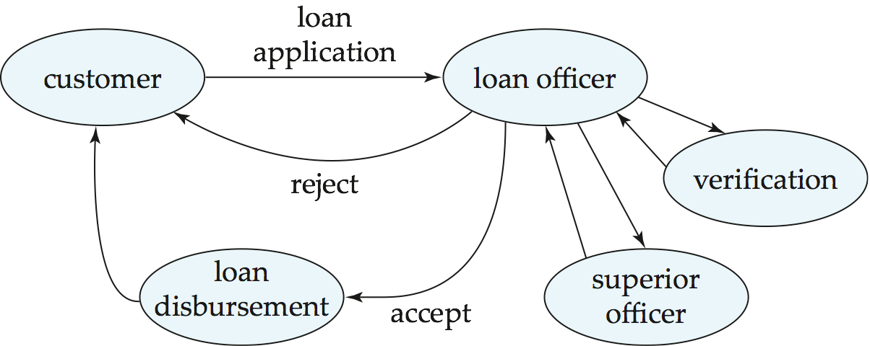
Loan Processing Workflow
In the past, workflows were handled by creating and forwarding paper forms
Computerized workflows aim to automate many of the tasks. But the humans still play role e.g., in approving loans.

Slide 14
Transactional Workflows
Must address following issues to computerize a workflow.
  Specification of workflows - detailing the tasks that must be carried out and defining the execution requirements.
  Execution of workflows - execute transactions specified in the workflow while also providing traditional database safeguards related to the correctness of computations, data integrity, and durability.
  E.g.: Loan application should not get lost even if system fails.
Extend transaction concepts to the context of workflows.
State of a workflow - consists of the collection of states of its constituent tasks, and the states (i.e., values) of all variables in the execution plan.

Slide 15
Workflow Specification
Static specification of task coordination:
  Tasks and dependencies among them are defined before the execution of the workflow starts.
  Can establish preconditions for execution of each task: tasks are executed only when their preconditions are satisfied.
  Defined preconditions through dependencies:
    Execution states of other tasks.
“task t_{i} cannot start until task t_{j} has ended”
    Output values of other tasks.
  “task t_{i} can start if task t_{j} returns a value greater than 25”
    External variables, that are modified by external events.
“task t_{i} must be started within 24 hours of the completion of task t_{j}”

Slide 16
Workflow Specification (Cont.)
Dynamic task coordination
E.g., Electronic mail routing system in which the text to be schedule for a given mail message depends on the destination address and on which intermediate routers are functioning.

Slide 17
Failure-Automicity Requirements
Usual ACID transactional requirements are too strong/ unimplementable for workflow applications.
However, workflows must satisfy some limited transactional properties that guarantee a process is not left in an inconsistent state.
Acceptable termination states - every execution of a workflow will terminate in a state that satisfies the failure-atomicity requirements defined by the designer.
  Committed - objectives of a workflow have been achieved.
  Aborted - valid termination state in which a workflow has failed to achieve its objectives.
A workflow must reach an acceptable termination state even in the presence of system failures.

Slide 18
Execution of Workflows
Workflow management systems include:
Scheduler - program that process workflows by submitting various tasks for execution, monitoring various events, and evaluation conditions related to intertask dependencies
Task agents - control the execution of a task by a processing entity.
Mechanism to query to state of the workflow system.

Slide 19
Workflow Management System Architectures
Centralized - a single scheduler schedules the tasks for all concurrently executing workflows.
  used in workflow systems where the data is stored in a central database.
  easier to keep track of the state of a workflow.
Partially distributed - has one (instance of a) scheduler for each workflow.
Fully distributed - has no scheduler, but the task agents coordinate their execution by communicating with each other to satisfy task dependencies and other workflow execution requirements.
  used in simplest workflow execution systems
  based on electronic mail

Slide 20
Workflow Scheduler
Ideally scheduler should execute a workflow only after ensuring that it will terminate in an acceptable state.
Consider a workflow consisting of two tasks S₁ and S₂. Let the failure-atomicity requirement be that either both or neither of the subtransactions should be committed.
  Suppose systems executing S₁ and S₂ do not provide prepared-to-commit states and S₁ or S₂ do not have compensating transactions.
  It is then possible to reach a state where one subtransaction is committed and the other aborted. Both cannot then be brought to the same state.
  Workflow specification is unsafe, and should be rejected.
Determination of safety by the scheduler is not possible in general, and is usually left to the designer of the workflow.

Slide 21
Recovery of a Workflow
Ensure that is a failure occurs in any of the workflow-processing components, the workflow eventually reaches an acceptable termination state.
Failure-recovery routines need to restore the state information of the scheduler at the time of failure, including the information about the execution states of each task. Log status information on stable storage.
Handoff of tasks between agents should occur exactly once in spite of failure.
Problem: Repeating handoff on recovery may lead to duplicate execution of task; not repeating handoff may lead to task not being executed.
  Solution: Persistent messaging systems

Slide 22
Recovery of a Workflow (Cont.)
Persistent messages: messages are stored in permanent message queue and therefore not lost in case of failure.
Before an agent commits, it writes to the persistent message queue whatever messages need to be sent out.
The persistent message system must make sure the messages get delivered eventually if and only if the transaction commits.
The message system needs to resend a message when the site recovers, if the message is not known to have reached its destination.
Messages must be logged in stable storage at the receiving end to detect multiple receipts of a message.

Slide 23
E-Commerce
E-commerce refers to the process of carrying out various activities related to commerce, through electronic means, primarily through the Internet.
  Presale activities, needed to inform the potential buyer about the product or service being sold.
  The sale process, which includes negotiations on price and quality of service, and other contractual matters.
  The marketplace: When there are multiple sellers and buyers for a product, a marketplace, such as a stock exchange, helps in negotiating the price to be paid for the product. Auctions are used when there is a single seller and multiple buyers, and reverse auctions are used when there is a single buyer and multiple sellers.
  Activities related to delivery of the product or service.
  Customer support and postsale service.
  Databases are used extensively to support these activities.

Slide 24
E-Catalogs
Any e-commerce site provides users with a catalog of the products and services that the site supplies.
An e-catalog must provide browsing and search facilities to help customers find the product for which they are looking.
E-catalogs should also provide a means for customers to easily compare alternatives from which to choose among competing products.
E-catalogs can be customized for the customer. For instance, a retailer may have an agreement with a large company to supply some products at a discount.
Catalogs can also be personalized to individual users, on the basis of past buying history.

Slide 25
Marketplaces
When there are multiple sellers or multiple buyers (or both) for a product, a marketplace helps in negotiating the price to be paid for the product. There are several different types of marketplaces:
• In a reverse auction system a buyer states requirements, and sellers bid for supplying the item. The supplier quoting the lowest price wins. In a closed bidding system, the bids are not made public, whereas in an open bidding system the bids are made public.
• In an auction there are multiple buyers and a single seller. For simplicity, assume that there is only one instance of each item being sold. Buyers bid for the items being sold, and the highest bidder for an item gets to buy the item at the bid price.
In an exchange, such as a stock exchange, there are multiple sellers and multiple buyers. Buyers can specify the maximum price they are willing to pay, while sellers specify the minimum price they want. There is usually a market maker who matches buy and sell bids, deciding on the price for each trade.

Slide 26
Database issues in handling marketplaces are:
• Bidders need to be authenticated before they are allowed to bid.
• Bids (buy or sell) need to be recorded securely in a database. Bids need to be communicated quickly to other people involved in the marketplace (such as all the buyers or all the sellers).
• Delays in broadcasting bids can lead to financial losses to some participants.
• The volumes of trades may be extremely large at times of stock market volatility, or toward the end of auctions. Thus, very high performance databases with large degrees of parallelism are used for such systems.

Slide 27
Order Settlement
After items have been selected (perhaps through an electronic catalog) and the price determined (perhaps by an electronic marketplace), the order has to be settled. Settlement involves payment for goods and the delivery of the goods.
A simple but unsecure way of paying electronically is to send a credit-card number. There are two major problems.
First, credit-card fraud is possible. When a buyer pays for physical goods, companies can ensure that the address for delivery matches the cardholder’s address, so no one else can receive the goods, but for goods delivered electronically no such check is possible.
Second, the seller has to be trusted to bill only for the agreed-on item and to not pass on the card number to unauthorized people who may misuse it.

Slide 28
Several protocols are available for secure payments that avoid both the problems listed above. In addition, they provide for better privacy, whereby the seller may not be given any unnecessary details about the buyer, and the credit-card company is not provided any unnecessary information about the items purchased.
All information transmitted must be encrypted so that anyone intercepting the data on the network cannot find out the contents. Public-/private-key encryption is widely used for this task.
The protocols must also prevent person-in-the-middle attacks, where someone can impersonate the bank or credit-card company, or even the seller, or buyer, and steal secret information.
Impersonation is prevented by a system of digital certificates, whereby public keys are signed by a certification agency, whose public key is well known.

Slide 29
Secure Electronic Transaction (SET) protocol. The protocol requires several rounds of communication between the buyer, seller, and the bank, in order to guarantee safety of the transaction.
Today, many banks provide secure payment gateways which allow a purchaser to pay online at the banks Web site, without exposing credit card or bank account information to the online merchant.

Slide 30
Main-Memory Database
To allow a high rate of transaction processing (hundreds or thousands of transactions per second), we must use high-performance hardware, and must exploit parallelism.
Disk I/O remains a bottleneck—about 10 milliseconds are required for each I/O, and this number has not decreased at a rate comparable to the increase in processor speeds.
Disk I/O is often the bottleneck for reads, as well as for transaction commits.
The long disk latency increases not only the time to access a data item, but also limits the number of accesses per second.
We can make a database system less disk bound by increasing the size of the database buffer.
Advances in main-memory technology let us construct large main memories at relatively low cost.

Slide 31
Main-Memory Database
Commercial 64-bit systems can support main memories of tens of gigabytes.
Oracle TimesTen is a currently available main-memory database. since data are memory resident.
Memory resident data allows faster processing of transactions, since data are memory resident.
Disk-related limitations:
  Logging is a bottleneck when transaction rate is high.
  Use group-commit to reduce number of output operations.
  If the update rate for modified buffer blocks is high, the disk data-transfer rate could become a bottleneck.
  If the system crashes, all of main memory is lost.

Slide 32
Main-Memory Database Optimizations
On the other hand, a main-memory database provides opportunities for optimizations:
To reduce space overheads, main-memory databases can use structures with pointers crossing multiple pages. In disk databases, the I/O cost to traverse multiple pages would be excessively high.
No need to pin buffer pages in memory before data are accessed, since buffer pages will never be replaced.
Design query-processing techniques to minimize space overhead - avoid exceeding main memory limits during query evaluation.
Improve implementation of operations such as locking and latching, so they do not become bottlenecks.
Optimize recovery algorithms, since pages rarely need to be written out to make space for other pages.

Slide 33
Group Commit
The process of committing a transaction T requires these records to be written to stable storage:
  • All log records associated with T that have not been output to stable storage.
  • The <T commit> log record.
Idea: Instead of performing output of log records to stable storage as soon as a transaction is ready to commit, wait until
  log buffer block is full, or
  a transaction has been waiting sufficiently long after being ready to commit
Results in fewer output operations per committed transaction, and correspondingly a higher throughput.
However, commits are delayed until a sufficiently large group of transactions are ready to commit, or a transaction has been waiting long enough-leads to slightly increased response time.
Above delay acceptable in high-performance transaction systems since log buffer blocks will fill up quickly.

Slide 34
Real-Time Transaction Systems
In systems with real-time constraints, correctness of execution involves both database consistency and the satisfaction of deadlines.
  Hard deadline – Serious problems may occur if task is not completed within deadline
  Firm deadline - The task has zero value if it completed after the deadline.
  Soft deadline - The task has diminishing value if it is completed after the deadline.
The wide variance of execution times for read and write operations on disks complicates the transaction management problem for time-constrained systems
  main-memory databases are thus often used
  Waits for locks, transaction aborts, contention for resources remain as problems even if data is in main memory
Design of a real-time system involves ensuring that enough processing power exists to meet deadline without requiring excessive hardware resources.

Slide 35
Long Duration Transactions
Traditional concurrency control techniques do not work
well when user interaction is required:
Long duration: Design edit sessions are very long
Exposure of uncommitted data: E.g., partial update to a design
Subtasks: support partial rollback
Recoverability: on crash state should be restored even for yet-to-be committed data, so user work is not lost.
Performance: fast response time is essential so user time is not wasted.

Slide 36
Long-Duration Transactions
Represent as a nested transaction
  atomic database operations (read/write) at a lowest level.
If transaction fails, only active short-duration transactions abort.
Active long-duration transactions resume once any short duration transactions have recovered.
The efficient management of long-duration waits, and the possibility of aborts.
Need alternatives to waits and aborts; alternative techniques must ensure correctness without requiring serializability.

Slide 37
Concurrency Control
Correctness without serializability:
  Correctness depends on the specific consistency constraints for the databases.
  Correctness depends on the properties of operations performed by each transaction.
Use database consistency constraints as to split the database into subdatabases on which concurrency can be managed separately.
Treat some operations besides read and write as fundamental low-level operations and extend concurrency control to deal with them.

Slide 38
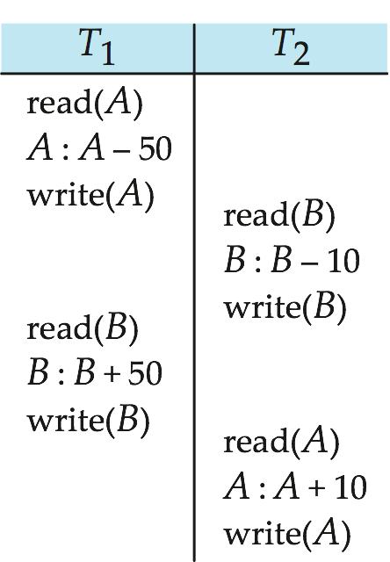
Concurrency Control (Cont.)
A non-conflict-serializable schedule that preserves the sum of A + B

Slide 39
Nested and Multilevel Transactions
A nested or multilevel transaction T is represented by a set
T = {t₁, t₂, ..., t_{n}} of subtransactions and a partial order P on T.
A subtransaction t_{i} in T may abort without forcing T to abort.
Instead, T may either restart t_{i}, or simply choose not to run t_{i}.
If t_{i} commits, this action does not make t_{i}, permanent (unlike the situation in Chapter 15). Instead, t_{i}, commits to T, and may still abort (or require compensation) if T aborts.
An execution of T must not violate the partial order P, i.e., if an edge t_{i} → t_{i} appears in the precedence graph, then t_{i} → t_{i} must not be in the transitive closure of P.

Slide 40
Nested and Multilevel Transactions (Cont.)
Subtransactions can themselves be nested/multilevel transactions.
  Lowest level of nesting: standard read and write operations.
Nesting can create higher-level operations that may enhance concurrency.
Types of nested/ multilevel transactions:
  Multilevel transaction: subtransaction of T is permitted to release locks on completion.
  Saga: multilevel long-duration transaction.
  Nested transaction: locks held by a subtransaction t_{i} of T are automatically assign to T on completion of t_{i}.

Slide 41
Example of Nesting
Rewrite transaction T₁ using subtransactions T_{a} and T_{b} that perform increment or decrement operations:
  T₁ consists of
    T₁,₁, which subtracts 50 from A
    T₁,₂, which adds 50 to B
Rewrite transaction T₂ using subtransactions T_{c} and T_{d} that perform increment or decrement operations:
  T₂ consists of
    T₂,₁, which subtracts 10 from B
    T₂,₂, which adds 10 to A
No ordering is specified on subtransactions; any execution generates a correct result.

Slide 42
Compensating Transactions
Alternative to undo operation; compensating transactions deal with the problem of cascading rollbacks.
Instead of undoing all changes made by the failed transaction, action is taken to “compensate” for the failure.
Consider a long-duration transaction T_{i} representing a travel reservation, with subtransactions T_{i,1}, which makes airline reservations, T_{i,2} which reserves rental cars, and T_{i,3} which reserves a hotel room.
  Hotel cancels the reservation.
  Instead of undoing all of T_{i}, the failure of T_{i},₃ is compensated for by deleting the old hotel reservation and making a new one.
  Requires use of semantics of the failed transaction.

Slide 43
Implementation Issues
For long-duration transactions to survive system crashes, we must log not only changes to the database, but also changes to internal system data pertaining to these transactions.
Logging of updates is made more complex by physically large data items (CAD design, document text); undesirable to store both old and new values.
Two approaches to reducing the overhead of ensuring the recoverability of large data items:
  Operation logging. Only the operation performed on the data item and the data-item name are stored in the log.
  Logging and shadow paging. Use logging from small data items; use shadow paging for large data items. Only modified pages need to be stored in duplicate.

Slide 44
Transaction Management in Multidatabase Systems
Transaction management is complicated in multidatabase systems because of the assumption of autonomy
  Global 2PL -each local site uses a strict 2PL (locks are released at the end); locks set as a result of a global transaction are released only when that transaction reaches the end.
    Guarantees global serializability
  Due to autonomy requirements, sites cannot cooperate and execute a common concurrency control scheme
    E.g., no way to ensure that all databases follow strict 2PL
Solutions:
  provide very low level of concurrent execution, or
  use weaker levels of consistency

Slide 45
Transaction Management
Local transactions are executed by each local DBMS, outside of the MDBS system control.
Global transactions are executed under multidatabase control.
Local autonomy - local DBMSs cannot communicate directly to synchronize global transaction execution and the multidatabase has no control over local transaction execution.
  local concurrency control scheme needed to ensure that DBMS’s schedule is serializable
  in case of locking, DBMS must be able to guard against local deadlocks.
  need additional mechanisms to ensure global serializability

Slide 46
Two-Level Serializability
DBMS ensures local serializability among its local transactions, including those that are part of a global transaction.
The multidatabase ensures serializability among global transactions alone- ignoring the orderings induced by local transactions.
2LSR does not ensure global serializability, however, it can fulfill requirements for strong correctness.
  1. Preserve consistency as specified by a given set of constraints
  2. Guarantee that the set of data items read by each transaction is consistent
Global-read protocol: Global transactions can read, but not update, local data items; local transactions do not have access to global data. There are no consistency constraints between local and global data items.

Slide 47
Two-Level Serializability (Cont.)
Local-read protocol: Local transactions have read access to global data; disallows all access to local data by global transactions.
A transaction has a value dependency if the value that it writes to a data item at one site depends on a value that it read for a data item on another site.
For strong correctness: No transaction may have a value dependency.
Global-read-write/local-read protocol: Local transactions have read access to global data; global transactions may read and write all data;
No consistency constraints between local and global data items.
No transaction may have value dependency.

Slide 48
Global Serializability
Even if no information is available concerning the structure of the various concurrency control schemes, a very restrictive protocol that ensures serializability is available.
Transaction-graph : a graph with vertices being global transaction names and site names.
An undirected edge (T_{i}, S_{k}) exists if T_{i} is active at site S_{k}.
Global serializability is assured if transaction-graph contains no undirected cycles.

Slide 49
Ensuring Global Serializability
Each site S_{i} has a special data item, called ticket
Every transaction T_{j} that runs at site S_{k} writes to the ticket at site S_{i}
Ensures global transactions are serialized at each site, regardless of local concurrency control method, so long as the method guarantees local serializability
Global transaction manager decides serial ordering of global transactions by controlling order in which tickets are accessed
However, above protocol results in low concurrency between global transactions.

Slide 50
End of Chapter 26

Slide 51
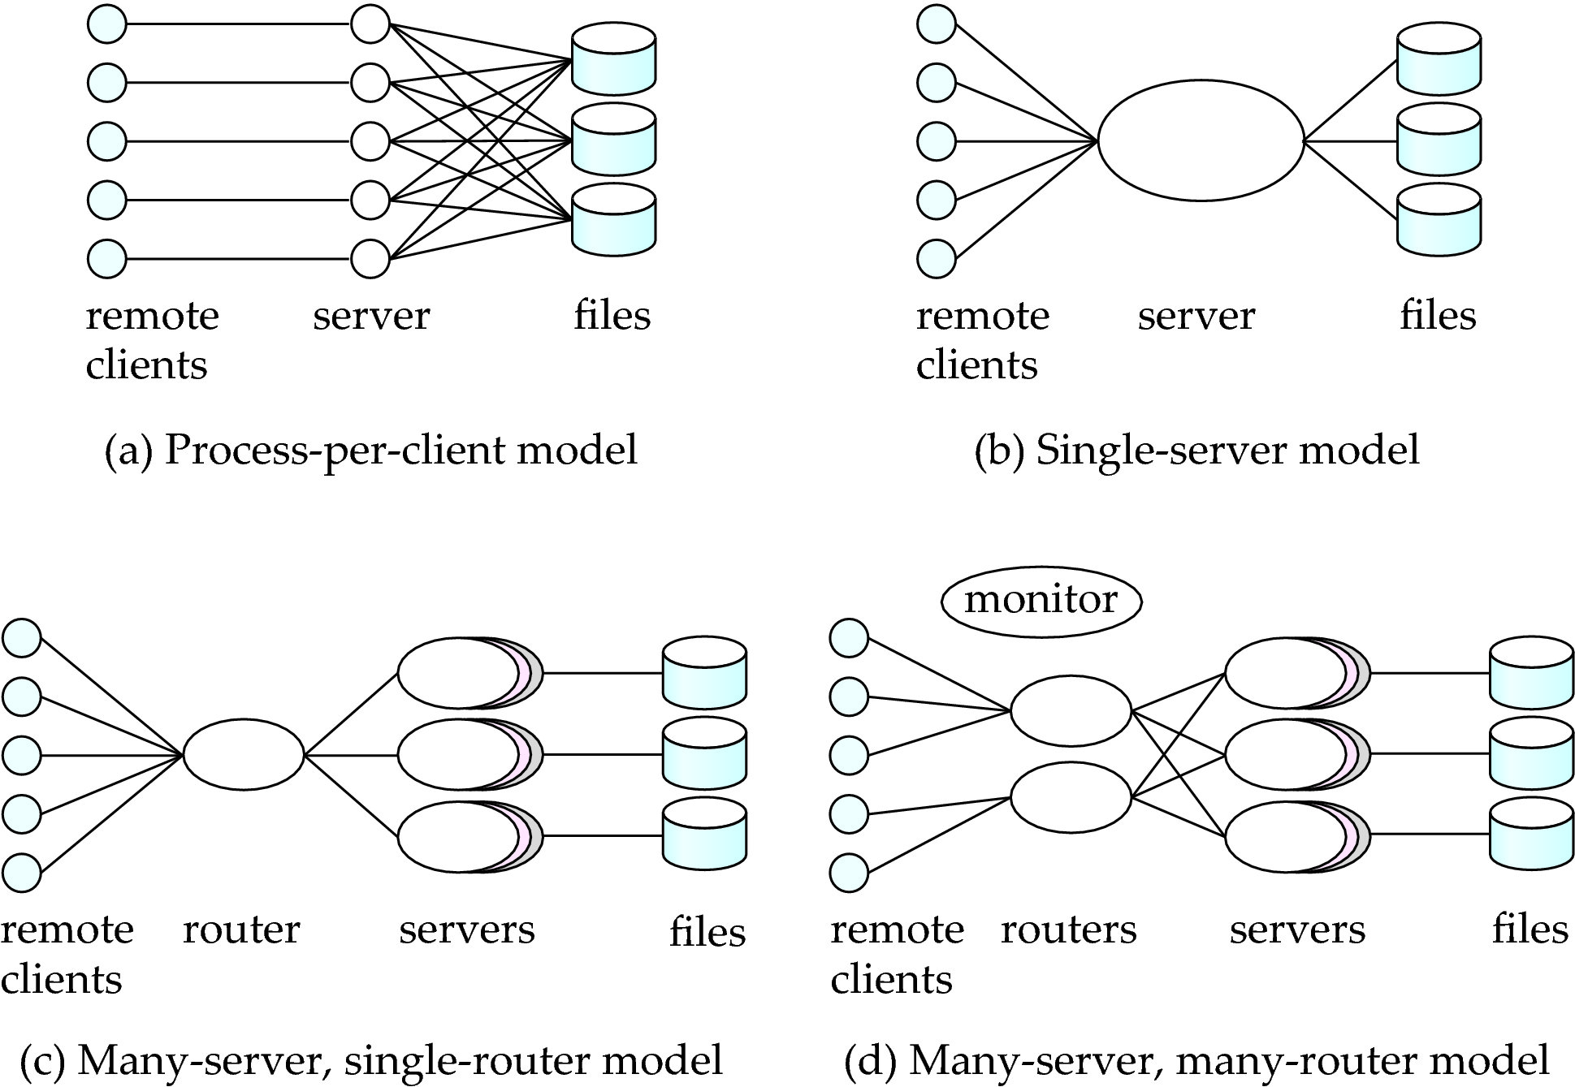
Figure 26.01

Slide 52
Figure 26.02

Slide 53
Figure 26.03

Slide 54
Figure 26.04

Slide 55
Figure 26.05

Slide 56
Extra slides

Slide 57
Weak Levels Consistency
Use alternative notions of consistency that do not ensure serializability, to improve performance.
Degree-two consistency avoids cascading aborts without necessarily ensuring serializability.
  Unlike two-phase locking, S-locks may be released at any time, and licks may be acquired at any time.
  X-locks be released until the transaction either commits or aborts.

Slide 58
Example Schedule with Degree-Two Consistency
Nonserializable schedule with degree-two consistency (Figure 20.5) where T₃ reads the value if Q before and after that value is written by T_{4.}
T₃
T₄
lock-S (Q)
read (Q)
unlock (Q)
lock-X (Q)
read (Q)
write (Q)
unlock (Q)
lock-S (Q)
read (Q)
unlock (Q)

Slide 59
Cursor Stability
Form of degree-two consistency designed for programs written in general-purpose, record-oriented languages (e.g., Pascal, C, Cobol, PL/I, Fortran).
Rather than locking the entire relation, cursor stability ensures that
  The tuple that is currently being processed by the iteration is locked in shared mode.
  Any modified tuples are locked in exclusive mode until the transaction commits.
Used on heavily accessed relations as a means of increasing concurrency and improving system performance.
Use is limited to specialized situations with simple consistency constraints.

